Slide 1



Biot-Savart Law
Performing various measures to study the magnetic field intensity variations around an inducting coil

Slide 2

Biot-Savart Law
Performing various measures to study the magnetic field intensity variations around an inducting coil
^{Objective}
The goal of the activity is to investigate the surroundings of an isolated copper coil, fed with a low voltage direct current source. Using the Biot-Savart law, measurments of magnetic flux intensity in different directions around the coil will allow students to determine the field-line distribution in space.

Slide 3

Biot-Savart Law
Performing various measures to study the magnetic field intensity variations around an inducting coil
^{Introduction and theory}
There is a constantly increasing amount of uses given to magnets and induced magnetic fields. Much of modern technology uses electro-magnetic induction as an electrical power source, but we know very little about the effects that magnets or the geometric characteristics of coils have on the resulting field-line space-distribution around them. An example of this can be given by comparing the amount of iron dust that a magnetized nail attracts to different curvatures on its surface.
How are distance and orientation relevant to interactions between magnets?

Slide 4
Biot-Savart Law
Performing various measures to study the magnetic field intensity variations around an inducting coil
^{Introduction and theory}
What action do you have to perform in order to identify the presence of a magnetic field?
What is the main feature of magnetic field lines?

Slide 5

Biot-Savart Law
Performing various measures to study the magnetic field intensity variations around an inducting coil
^{Introduction and theory}
^{Theoretical}
It is well known that magnetic fields originate due to the presence of an electric current or a stream of moving charged particles (Oersted’s experiment). It is also known by Galilean relativity that movement directions depend on relative position. The Biot-Savart law presents a mathematical expression for the magnitude and direction in a certain point in space of the magnetic field intensity (B) generated by a current (I) at a distance (R) of such point.
Electric current
Magnetic field intensity
Direction of field line
Distance to curent

Slide 6
Biot-Savart Law
Performing various measures to study the magnetic field intensity variations around an inducting coil
^{Introduction and theory}
^{Theoretical}
Magnetic field intensity is then a quantity that indicates a specific magnitude and direction of effect on every point around the electric current. This direction is always perpendicular to both current and position directions and it points out according to the vector product between each one’s unitary vectors.

Slide 7
Biot-Savart Law
Performing various measures to study the magnetic field intensity variations around an inducting coil
^{Introduction and theory}
Now, to determine a specific direction for a measure of magnetic field intensity from a certain point “P”, the perpendicular plane of this direction - containing both current and relative position between current and measuring area directions is used. Thus, a generalization for magnetic intensity in space is made, as the amount of field lines that perpendicularly cross a certain amount of surface.
^{Theoretical}

Slide 8
Biot-Savart Law
Performing various measures to study the magnetic field intensity variations around an inducting coil
^{Introduction and theory}
This generalization allows us to interpret measures of magnetic field intensity as a flux density per unit of area, showing the amount and direction of magnetic lines in space that cross a certain oriented surface.
Surface unit
Magnetic flux

Slide 9
Biot-Savart Law
Performing various measures to study the magnetic field intensity variations around an inducting coil
^{Introduction and theory}
Now students are encouraged to raise a hypothesis which must be tested with an experiment.
If a magnetic sensor is used to measure intensity along the interior and exterior of an electrified coil, how similar would the results be? How will the field lines behave near the coil’s edges?

Slide 10

Biot-Savart Law
Performing various measures to study the magnetic field intensity variations around an inducting coil
^{Activity description}
Students will measure magnetic intensity along an electrified coil’s axis, an exterior parallel line to the axis and an exterior perpendicular line to the axis. To perform these measurements they will use the Labdisc magnetic sensor.

Slide 11
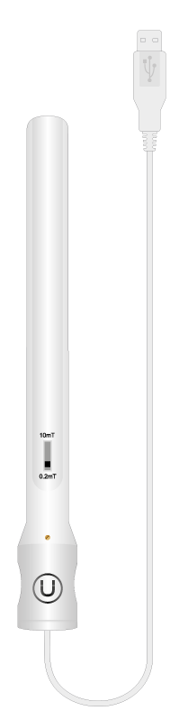
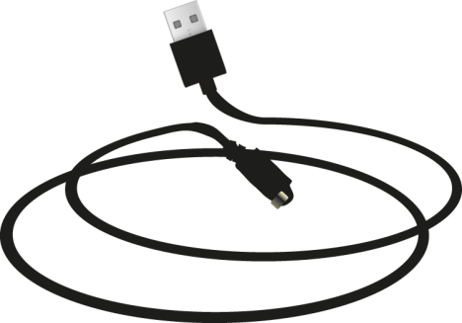
Biot-Savart Law
Performing various measures to study the magnetic field intensity variations around an inducting coil
^{Resources and materials}
Labdisc magnetic sensor
USB cable
5vDC power source
30 cm plastic ruler
65 turns and 4.5 cm diameter isolated 1 mm copper coil

Slide 12
Biot-Savart Law
Performing various measures to study the magnetic field intensity variations around an inducting coil
^{Using the Labdisc}
^{Labdisc configuration}
To collect intensity measurements with the Labdisc magnetic sensor, follow these steps:
Open the GlobiLab software and turn on the Labdisc.
Click on the Bluetooth icon in the bottom right corner of the GlobiLab screen. Select the Labdisc you are using currently. Once the Labdisc has been recognized by the software, the icon will change from a grey to blue color .
If you prefer a USB connection follow the previous instruction clicking on the USB icon. You will see the same color change when the Labdisc is recognized
.

Slide 13
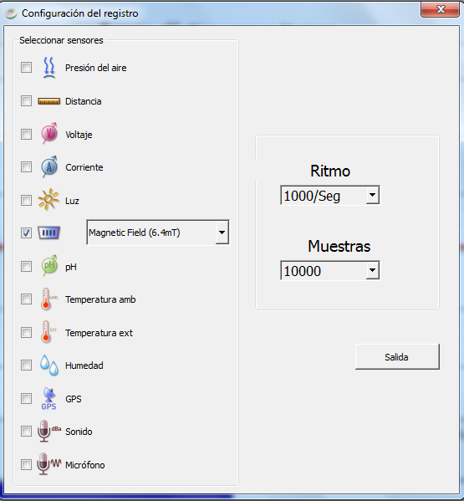
Biot-Savart Law
Performing various measures to study the magnetic field intensity variations around an inducting coil
^{Using the Labdisc}
Click on to configure the Labdisc. Select “Magnetic Field” in the “Logger Setup” window, enter “1000/Sec” for the sample frequency and enter “10000” for the number of samples.

Slide 14


Biot-Savart Law
Performing various measures to study the magnetic field intensity variations around an inducting coil
^{Using the Labdisc}
Once you have finished the sensor configuration start measuring by clicking .
Once you have finished measuring stop the Labdisc by clicking .

Slide 15
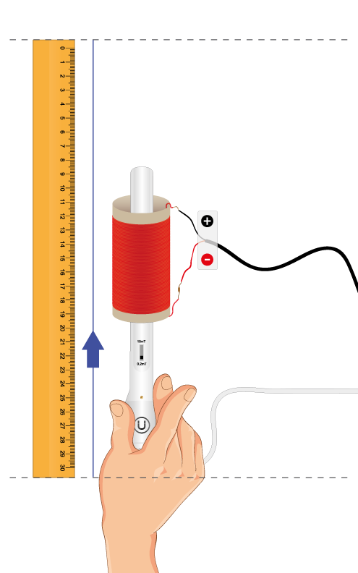
Biot-Savart Law
Performing various measures to study the magnetic field intensity variations around an inducting coil
^{Experiment}
Set the components as shown in the picture.
Move the probe as indicated by the arrow line.
Keep a steady rate of 3 cm/sec

Slide 16
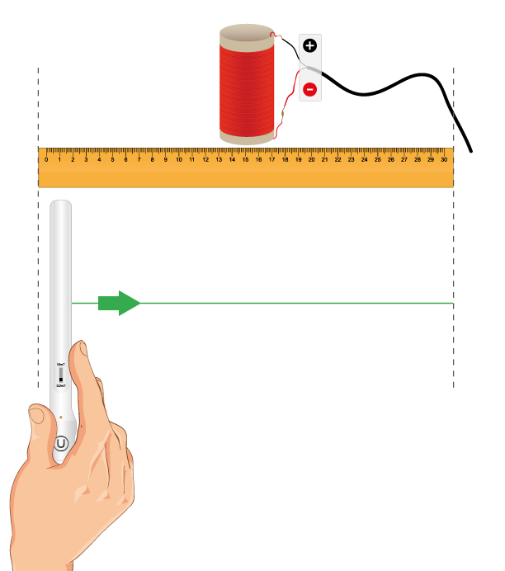
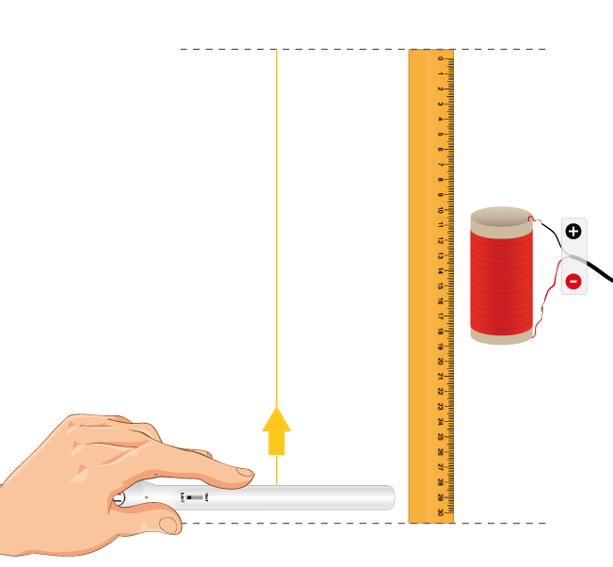
Biot-Savart Law
Endothermic and exothermic reactions
Performing different measurements to examine which reactions release or consume heat.
Performing various measures to study the magnetic field intensity variations around an inducting coil
^{Experiment}
^{Experiment}
Repeat the procedure above using these two other configurations:

Slide 17



Biot-Savart Law
Performing various measures to study the magnetic field intensity variations around an inducting coil
^{Results and analysis}
In each of the graphs indicate the points where the plot’s curvature changes using the two tools: and
Consider your movement of the probe as a constant speed of 3 cm/sec for each case and use the time scale as a distance scale.
After this, use the tool to relate these points with special features of the coil.

Slide 18

Biot-Savart Law
Performing various measures to study the magnetic field intensity variations around an inducting coil
^{Results and analysis}
Compare the measurements at the middle, center and edges of the coil in all graphs. How do these relate to your initial hypothesis?
What do negative values represent on the graphs?
What relation has the (+) and (-) power source connection set up on the results?

Slide 19
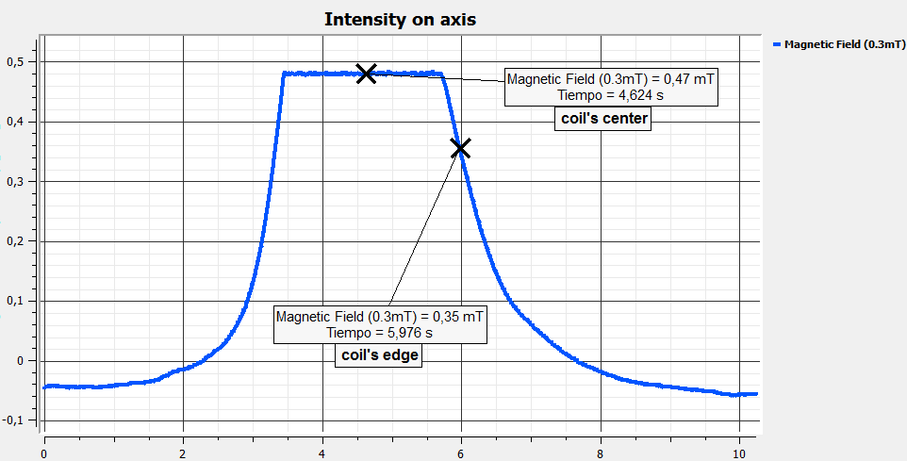
Biot-Savart Law
Performing various measures to study the magnetic field intensity variations around an inducting coil
^{Results and analysis}
The graph below should be similar to the one the students came up with:

Slide 20
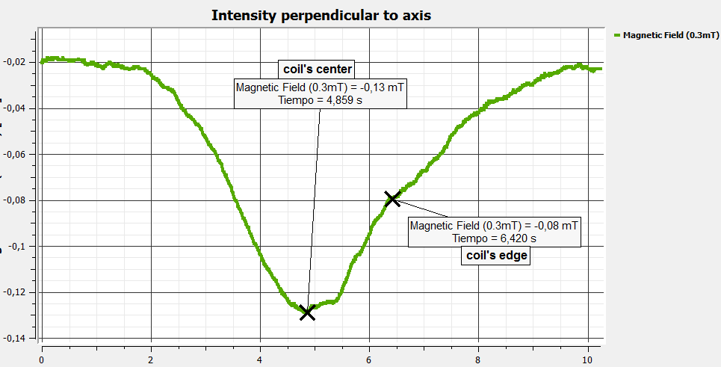
Biot-Savart Law
Performing various measures to study the magnetic field intensity variations around an inducting coil
^{Results and analysis}
The graph below should be similar to the one the students came up with:

Slide 21
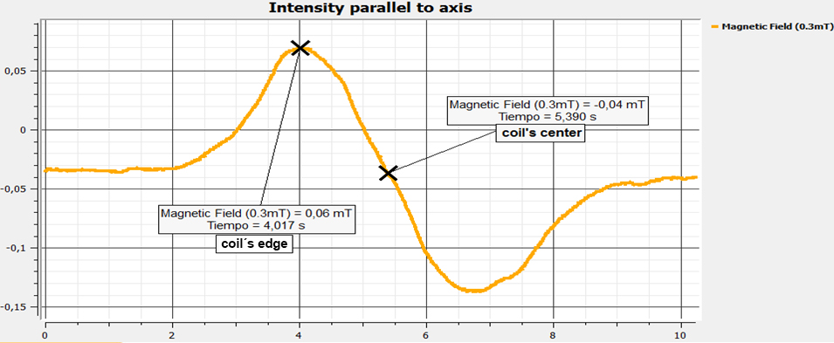
Biot-Savart Law
Performing various measures to study the magnetic field intensity variations around an inducting coil
^{Results and analysis}
The graph below should be similar to the one the students came up with:

Slide 22

Biot-Savart Law
Performing various measures to study the magnetic field intensity variations around an inducting coil
^{Conclusion}
For each graph, determine the regions where magnetic field lines are more compressed. Is there a relation between them and the coil’s geometry?
Students could present any graph according to the position of the sensor and the coil in each case. They could account the relation between the curvature changes on the graph and the field line distribution variations near the coil edges, center, and middle part.
Consider, for all three graphs the Biot-Savart law and the (+) and (-) connection set up to predict the direction of the field lines near both edges of the coil. Is this prediction consistent with the results?
Students could determine and draw the direction of the field lines around each of the coil’s edges and surroundings using the coil’s cylindrical symmetry, the Biot-Savart law, and the results from all three measurements.

Slide 23
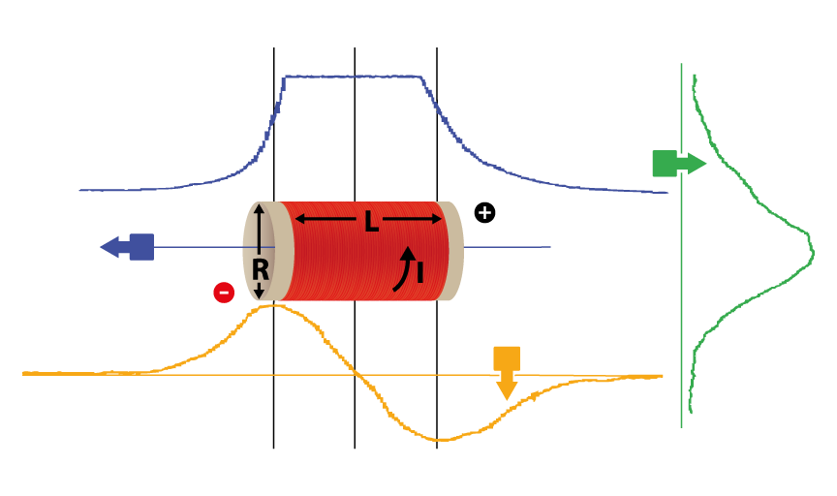
Biot-Savart Law
Performing various measures to study the magnetic field intensity variations around an inducting coil
^{Conclusion}

Slide 24
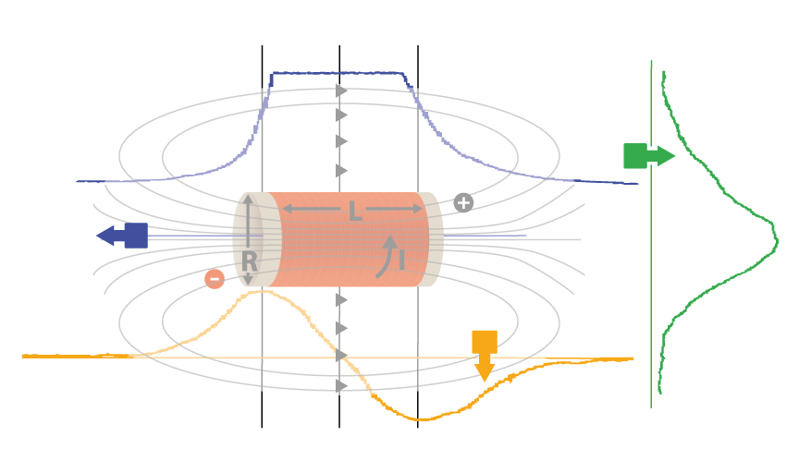
Biot-Savart Law
Performing various measures to study the magnetic field intensity variations around an inducting coil
^{Conclusion}

Slide 25

Biot-Savart Law
Performing various measures to study the magnetic field intensity variations around an inducting coil
Activities for further application
Can this knowledge be useful for creating strong magnetic fields?
Students could recognize that magnetic intensity is related with the amount and direction of field lines that cross a certain surface in a certain region of space. Thus, by studying the space distribution of field lines in different configurations of magnets and coils, it is possible to design specific systems that can bend or accumulate them in a small region.
What effect can a moving magnet have on a piece of conductor wire? Is this effect any different if the wire is curved as a ring? Use the Biot-Savart law to justify your answer and the Labdisc magnetic sensor to test it.
Students can justify their answer by using the vector product between current and relative position directions as a reference for field direction. Then determine the magnetic flux variation across the area that is constrained by the wire ring.

Slide 26


